Slide 1

Laboratory 4
Multi-Layer Perceptrons
Master in Big Data Solutions 2020-2021 - Artificial Intelligence
Luis Salgueiro
luis.salgueiro@bts.tech

Slide 2

Reminder
Is this webinar being recorded?

Slide 3
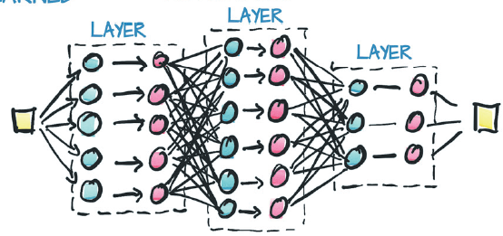
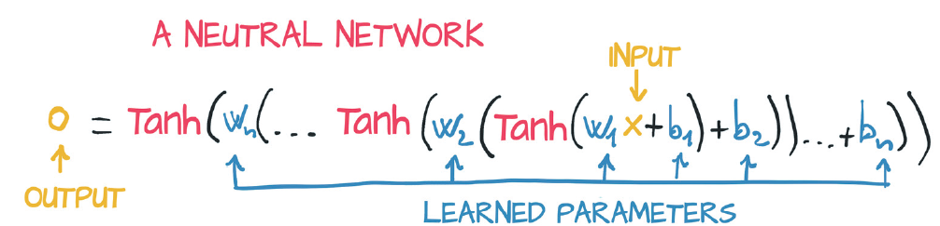
Multi-Layer Perceptron (MLP)
The connection of several perceptrons is called MLP.
The perceptrons are organized in groups called layers.
The mode in which the layers are connected is called architecture.
A MLP with 3 Layers.
Usually, the number of layers are referenced by the number of hidden layers.
Credits: Deep Learning with Pytorch. 2020
https://tex.stackexchange.com/questions/132444/diagram-of-an-artificial-neural-network

Slide 4
Agenda
In this lab exercises we are going to see:
How to define a MLP with Pytorch.
Dataset class and Dataloaders.
Introduction to the Torchvision library.

Slide 5
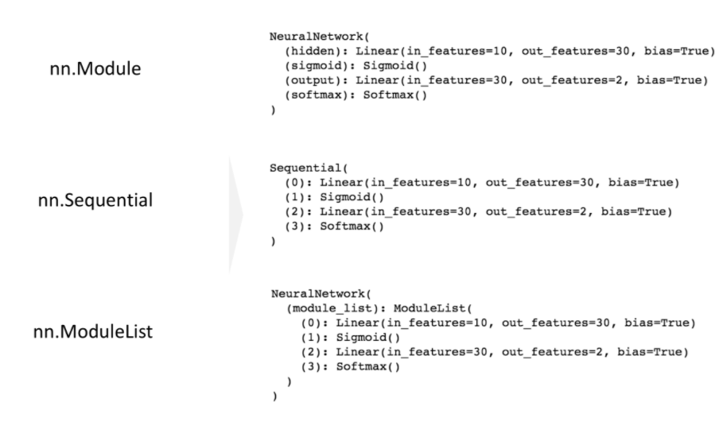
Torch.nn for define the Network
Three ways to define a network architecture.
Credits: https://h1ros.github.io/posts/3-ways-of-creating-a-neural-network-in-pytorch/

Slide 6
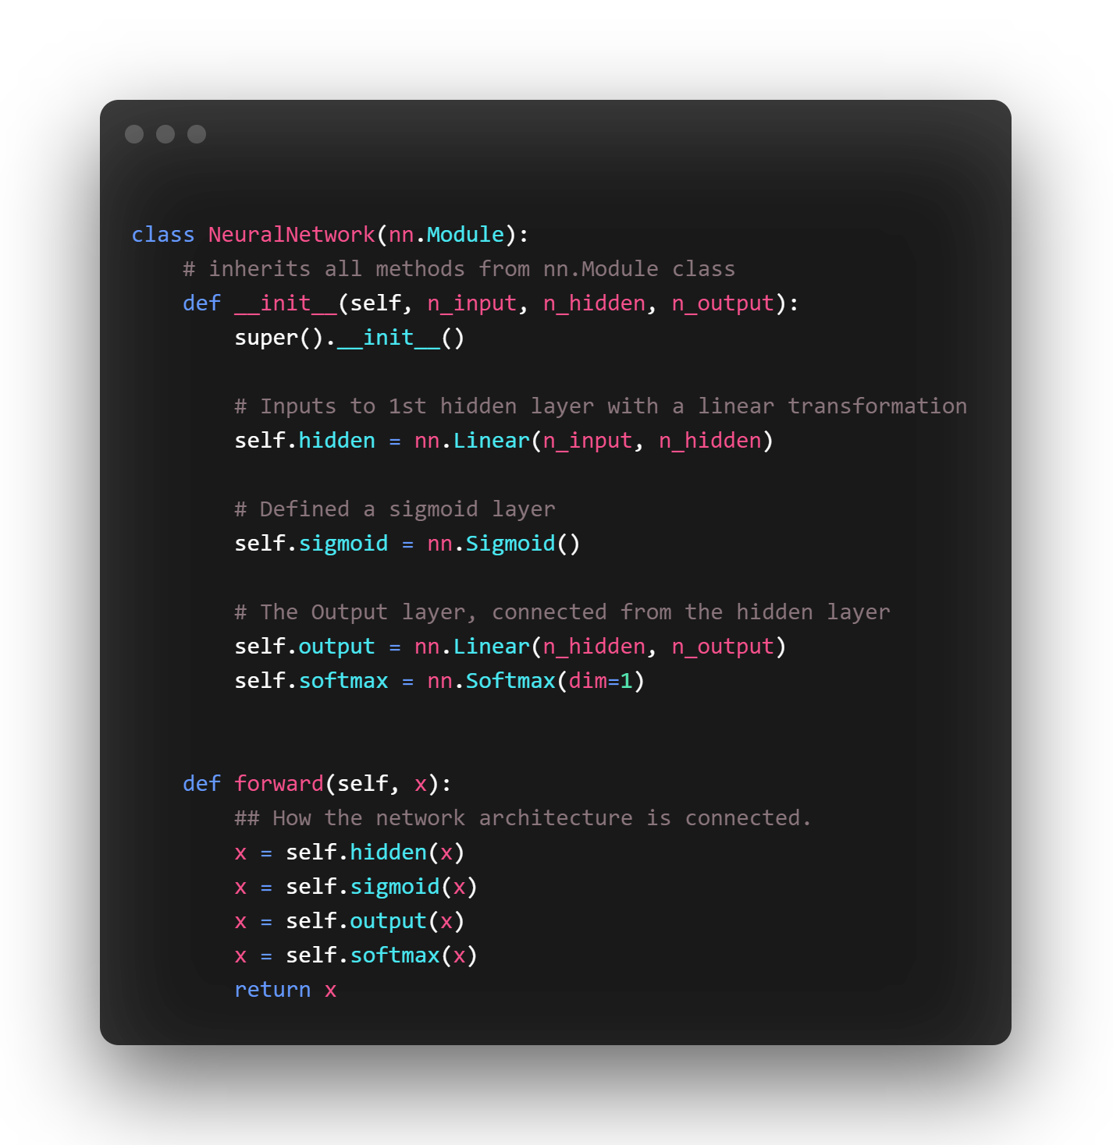
Torch.nn for define the Network
nn.Module is the default mode. Allows more flexibility and clarity.
Credits: https://h1ros.github.io/posts/3-ways-of-creating-a-neural-network-in-pytorch/

Slide 7
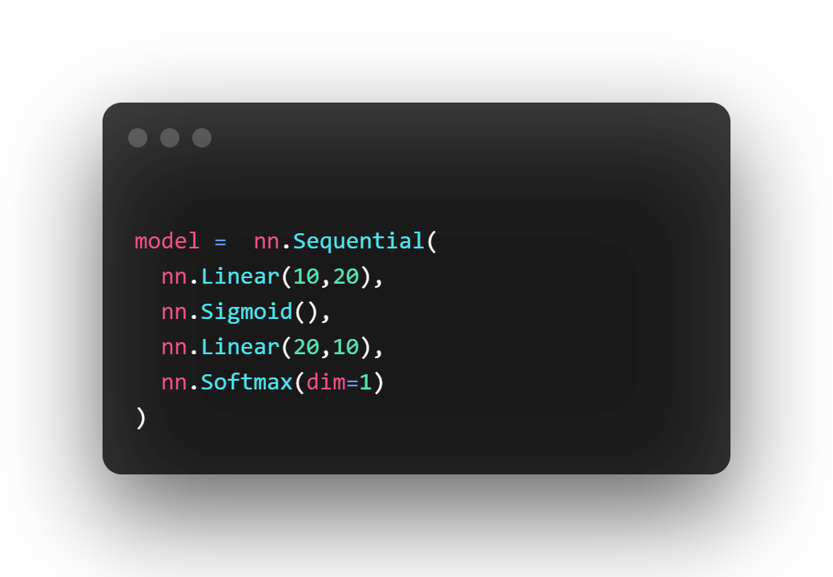
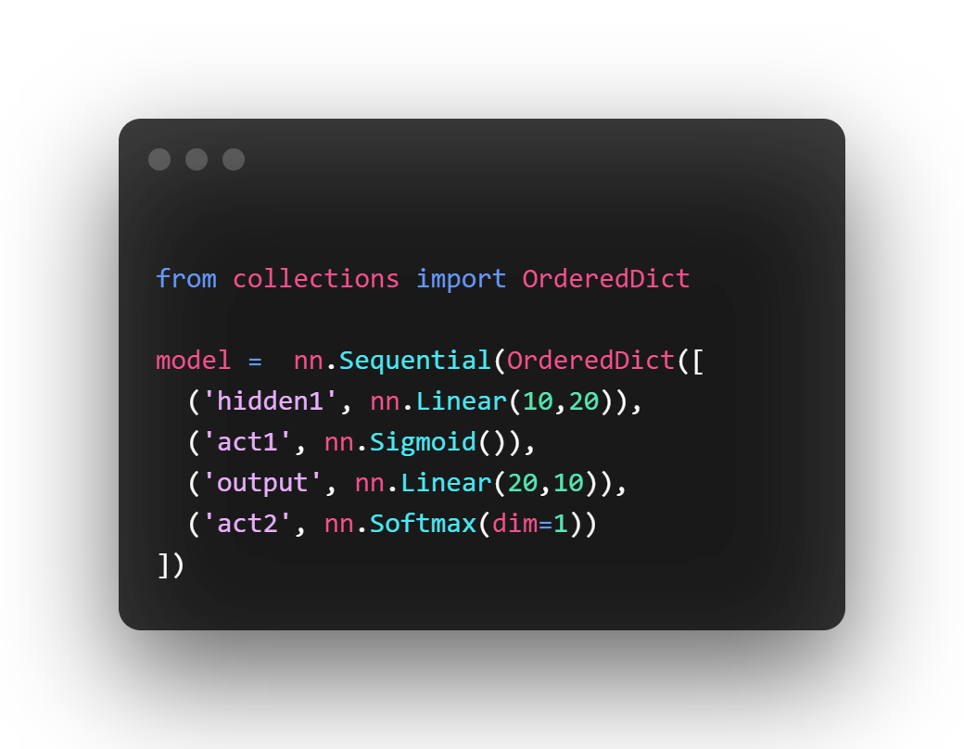
Torch.nn for define the Network
nn.Sequential() allows to stack layers in a feed-forward manner.
Credits: https://h1ros.github.io/posts/3-ways-of-creating-a-neural-network-in-pytorch/

Slide 8
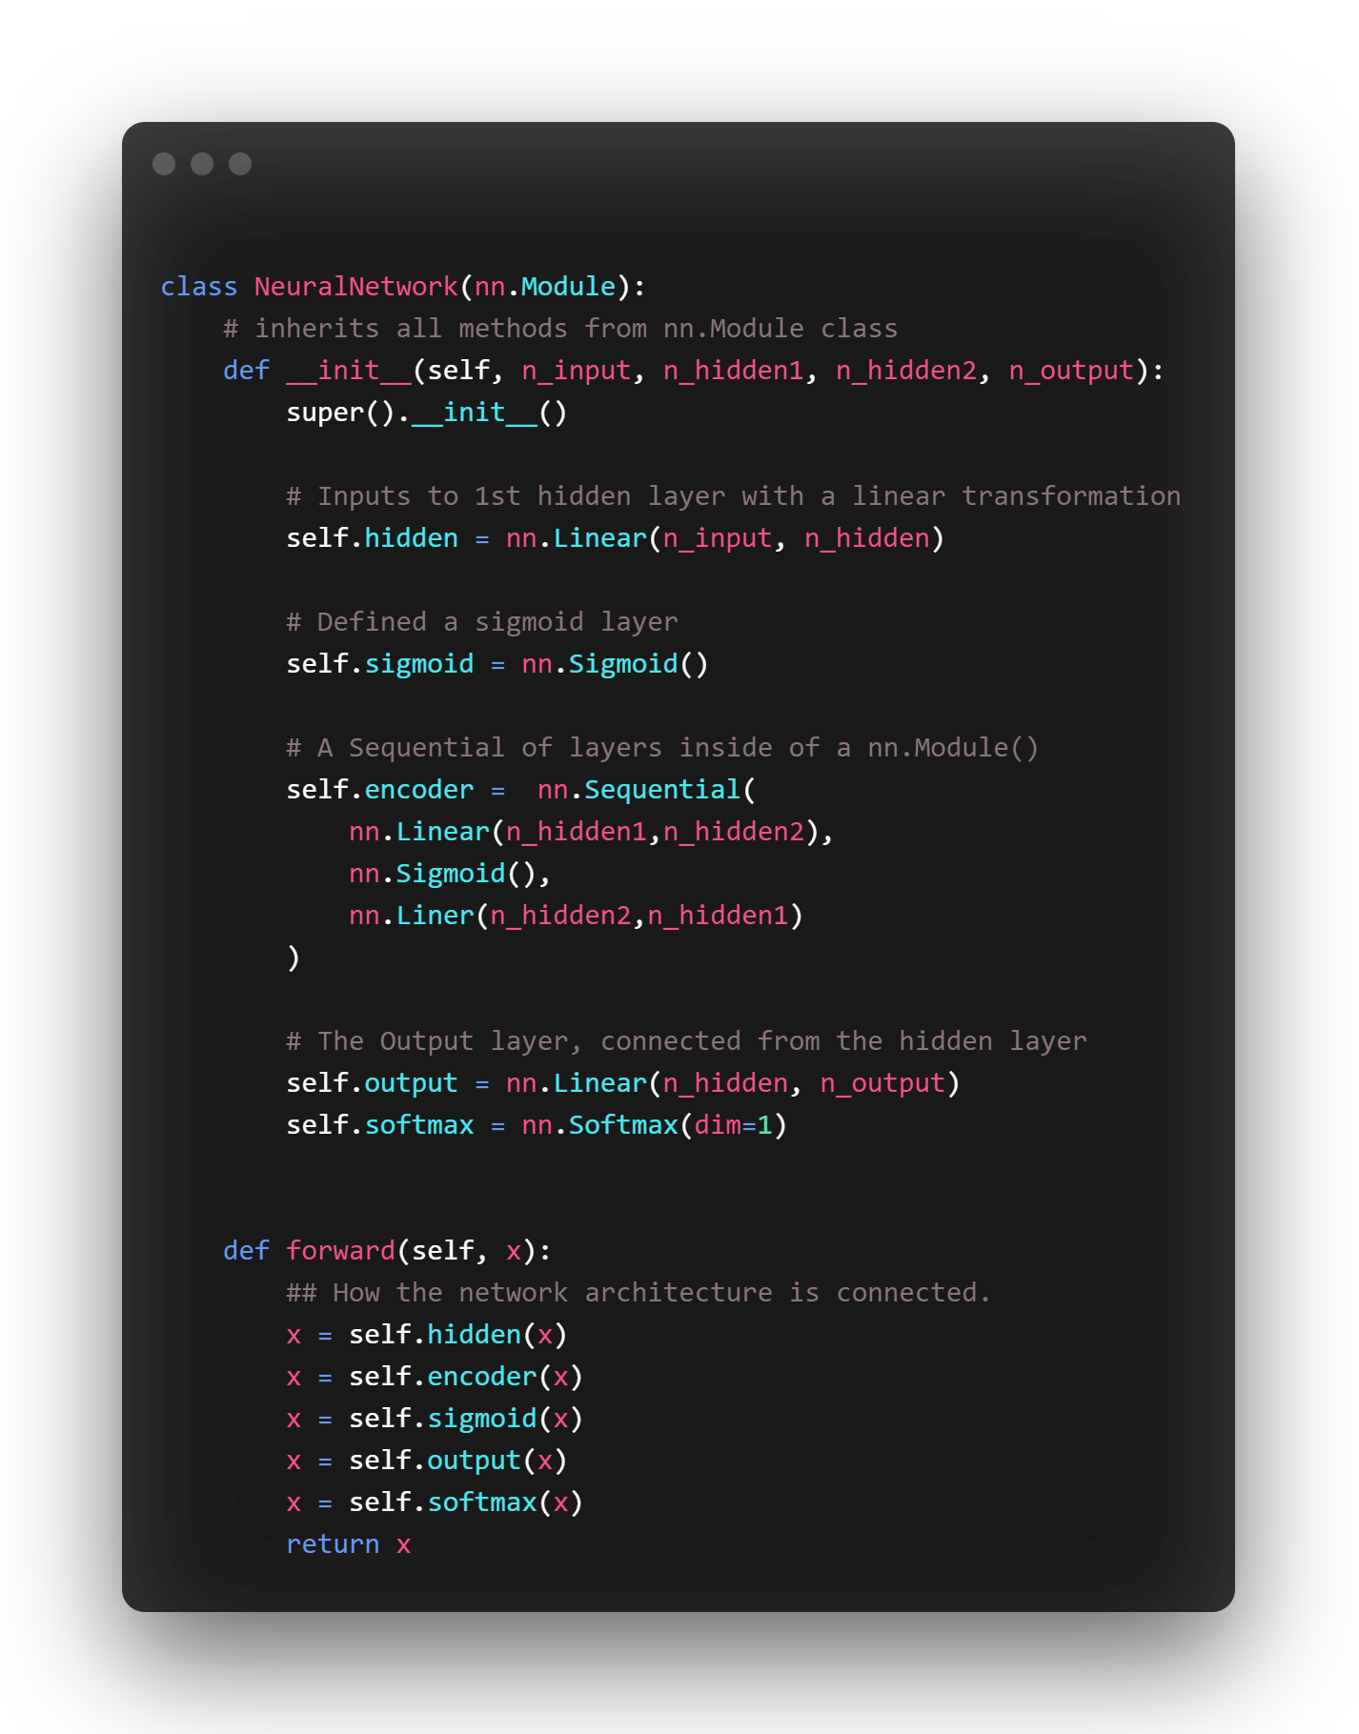
Torch.nn for define the Network
A mixture of nn.Sequential and nn.Module
Credits: https://h1ros.github.io/posts/3-ways-of-creating-a-neural-network-in-pytorch/

Slide 9
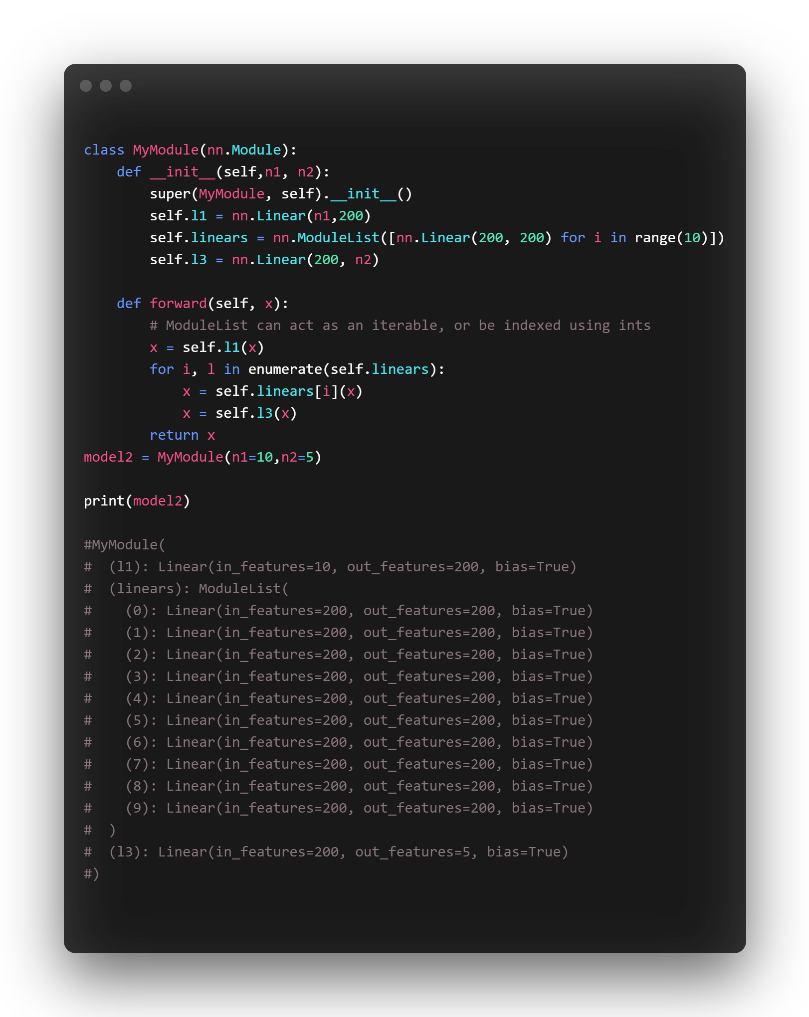
Torch.nn for define the Network
nn.ModuleList()
Permit to store layers
In a python list.
Useful for iterative mode
Credits: https://h1ros.github.io/posts/3-ways-of-creating-a-neural-network-in-pytorch/

Slide 10
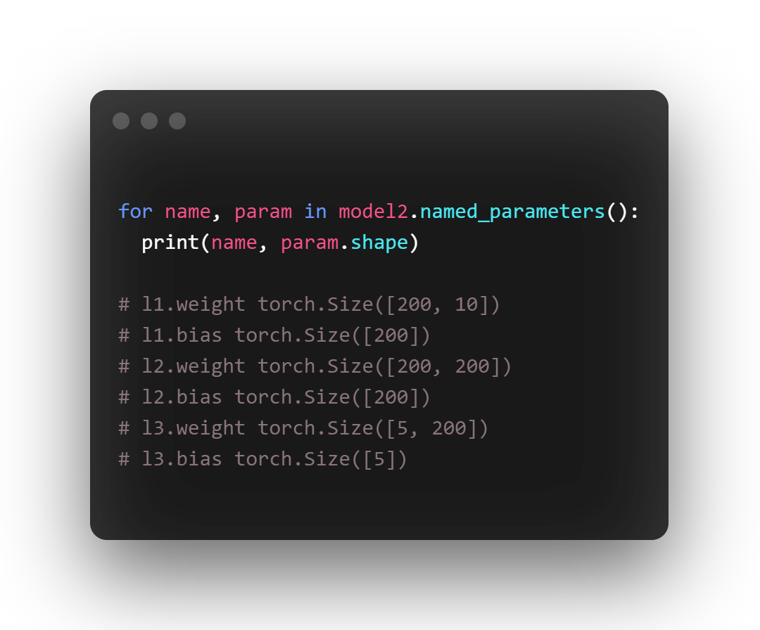
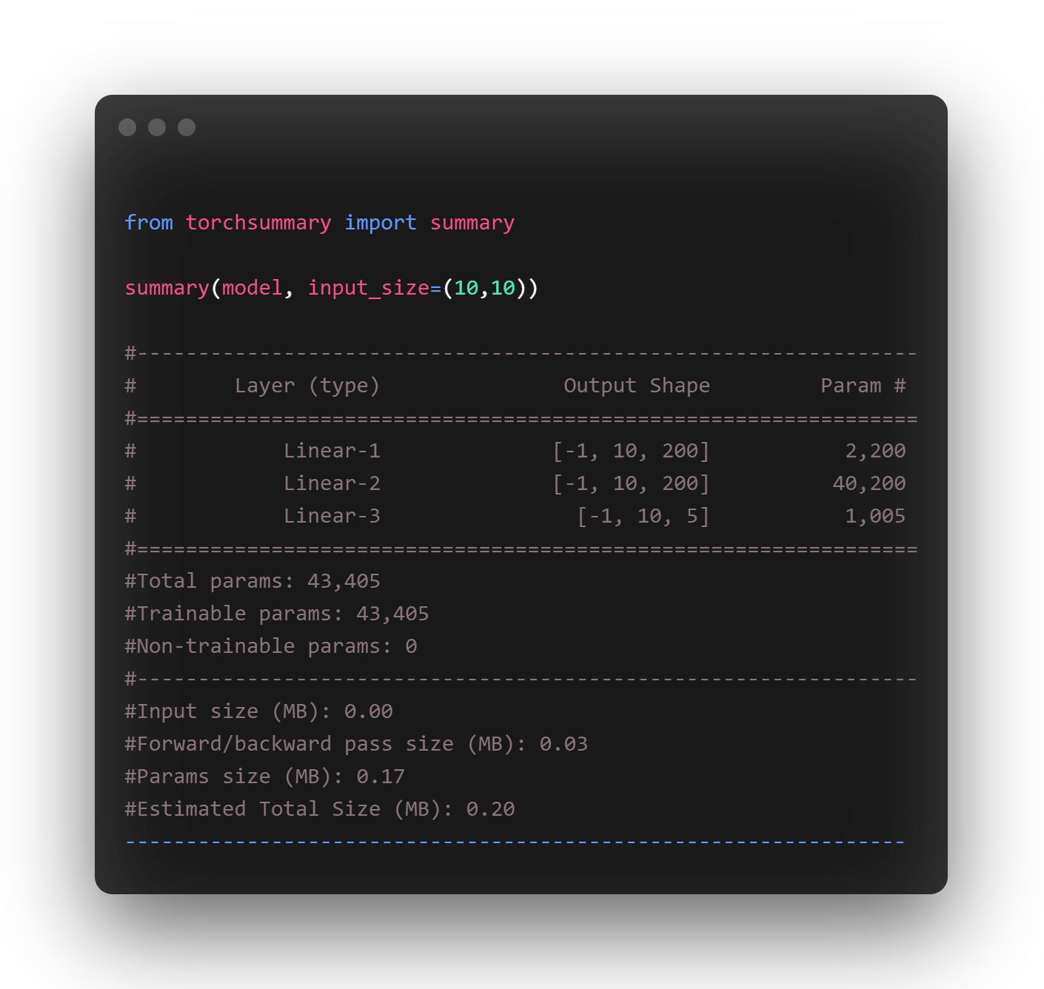
Torch.nn for define the Network
Explore the parameters and other attributes
Credits: https://h1ros.github.io/posts/3-ways-of-creating-a-neural-network-in-pytorch/

Slide 11
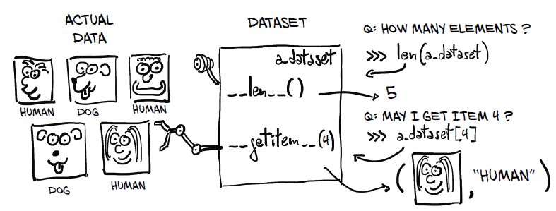
The class Dataset
Credits: Deep Learning with Pytorch. 2020

Slide 12
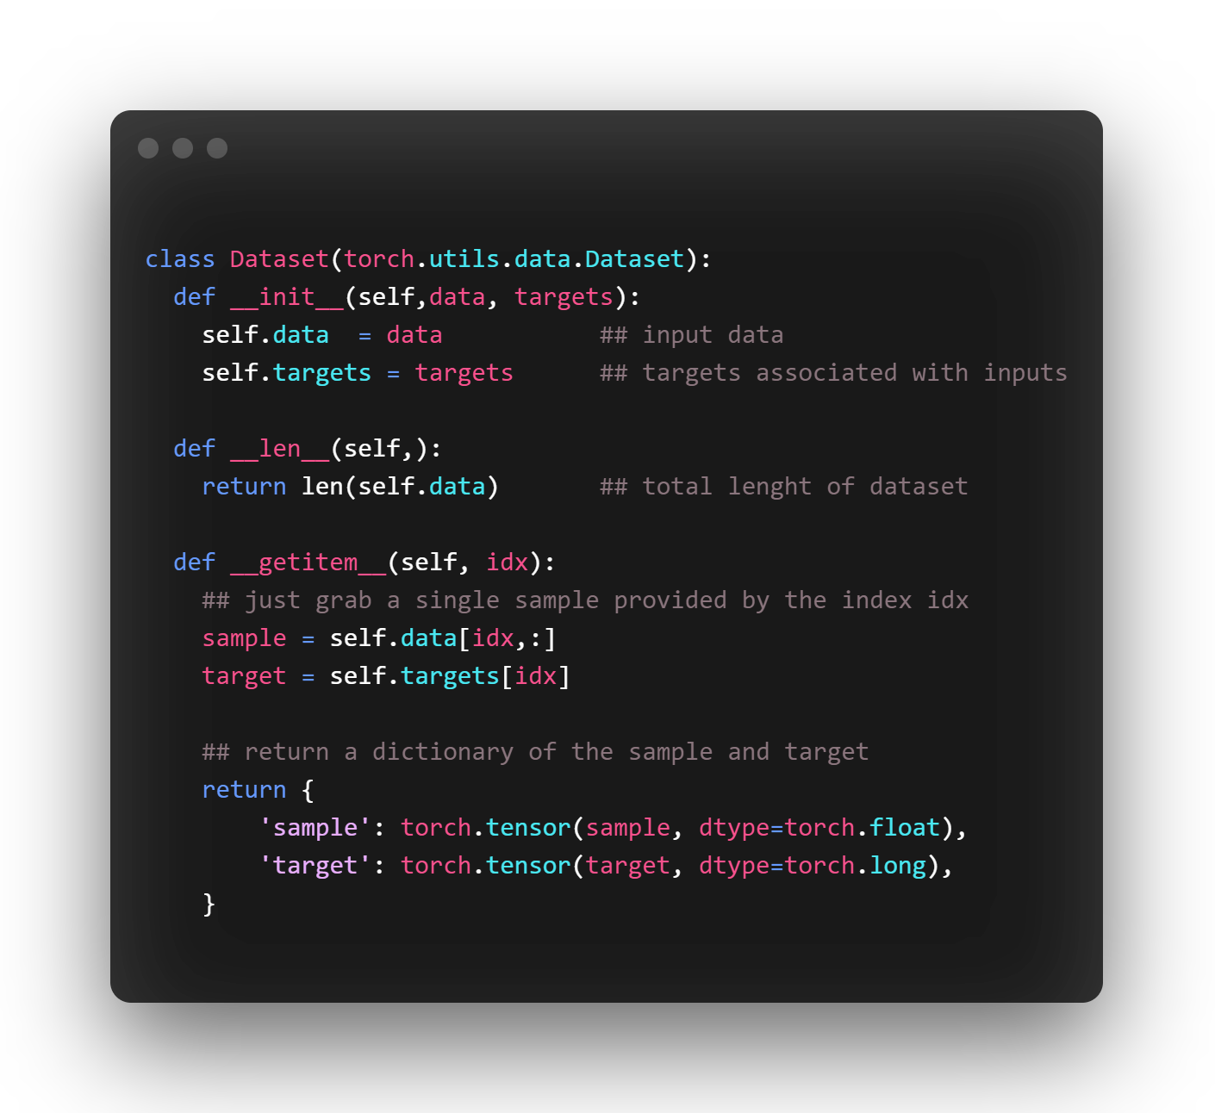
The class Dataset
Credits: https://majianglin2003.medium.com/pytorch-dataset-1b7273152f82
https://pytorch.org/tutorials/beginner/data_loading_tutorial.html

Slide 13
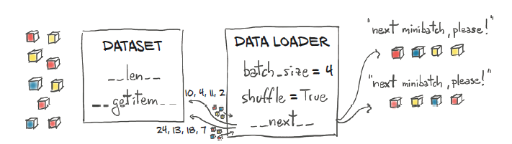
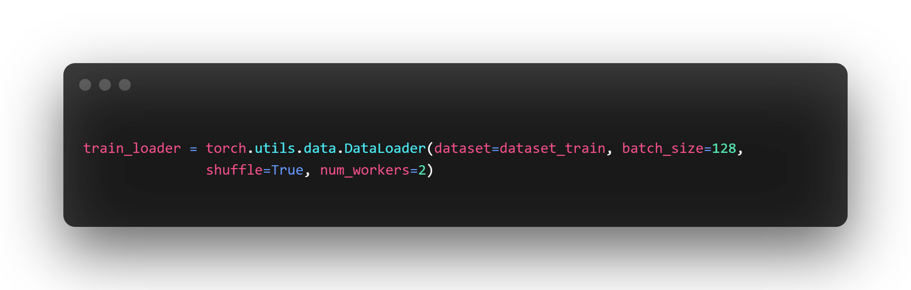
The class DataLoader
Credits: Deep Learning with Pytorch 2020.

Slide 14
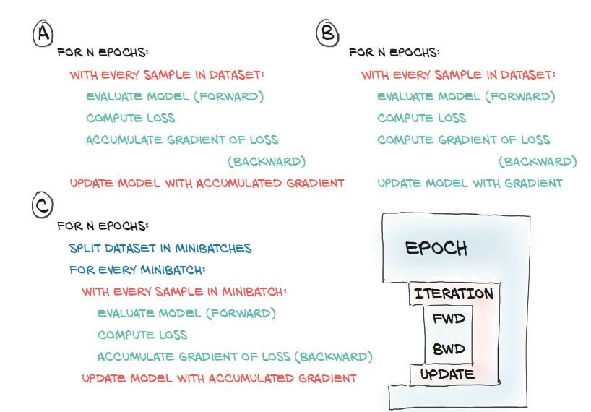
The class DataLoader
Credits: Deep Learning with Pytorch 2020.

Slide 15
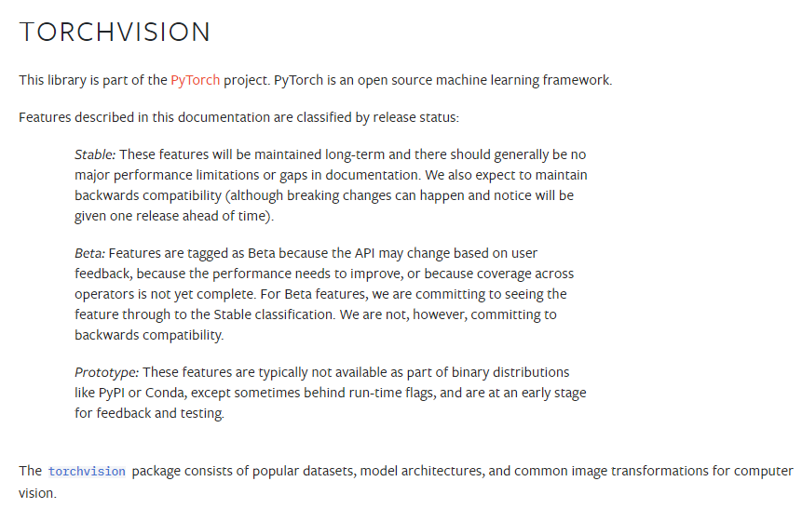
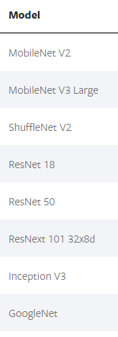
Torchvision
Credits: https://pytorch.org/vision/stable/index.html

Slide 16
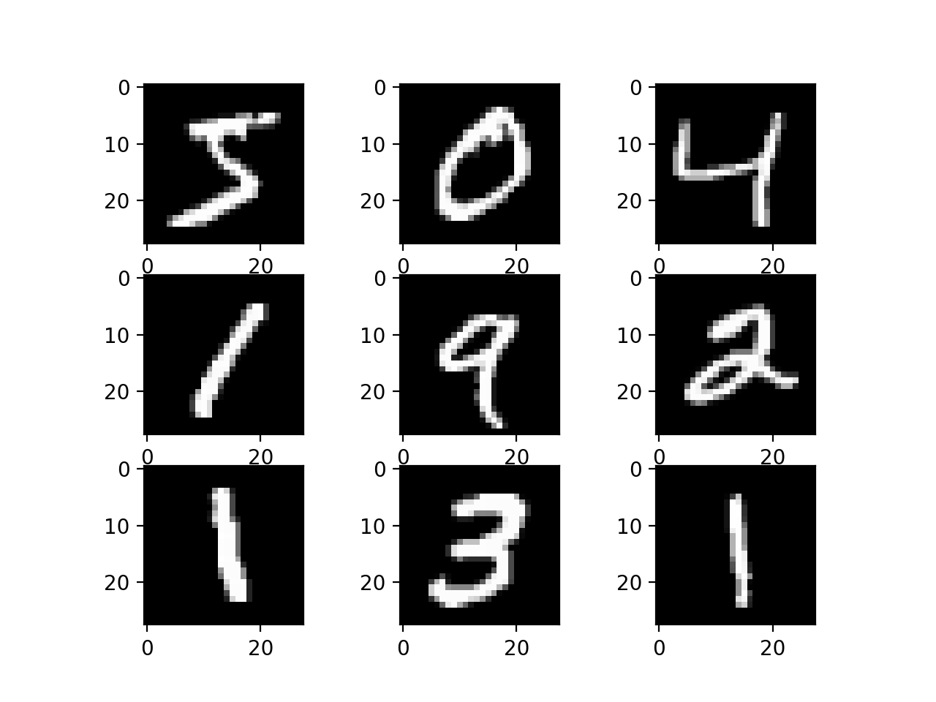
Laboratory exercise
Build a MLP for classify the MNIST dataset
Notes:
The idea is to minimize this cost function and so, to compute the rate of change of the loss with respect to each parameter of the model in the direction of the decreasing loss.
What is this eta symbol represent?

Slide 17


